Slide 1
Registration
MyUTK – Banner 9

Slide 2
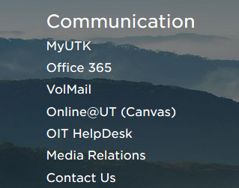
MyUTK
Log into MyUTK via the UTK homepage (https://www.utk.edu/)
If you are using a Mac the preferred browser is Firefox; if you are using a PC either Chrome or Firefox are compatible.
Scroll to the bottom left “Communication” area and click on MyUTK

Slide 3
Self Service Banner
After you have logged into MyUTK click on “Self Service Banner”
From the “Main Menu” choose “Student”

Slide 4
Student & Financial Aid
From the “Student & Financial Aid” menu choose “Registration”

Slide 5
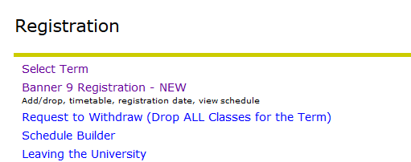
Registration
From the “Registration” menu choose “Banner 9 Registration – NEW”

Slide 6
NEW Banner Landing Page

Slide 7
What would you like to do?
You can choose to prepare for registration (view registration status, registration eligibility date, and academic program information)
You can “plan ahead” by making various schedules that fit your personal, academic, and work schedules in an effort to develop the best schedule for the upcoming semester

Slide 8
What would you like to do?
You can view registration information that includes past schedules and ungraded classes
You can browse the timetable for classes
You can browse the catalog

Slide 9
What would you like to do? Register!
Register for your classes
Using VA education benefits? Please visit the Veterans Resource Center before dropping a class, as it may affect your payments!

Slide 10
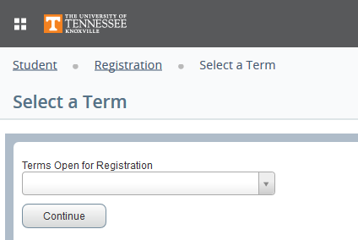
Register for classes
Select a Term from those currently available using the drop down menu

Slide 11
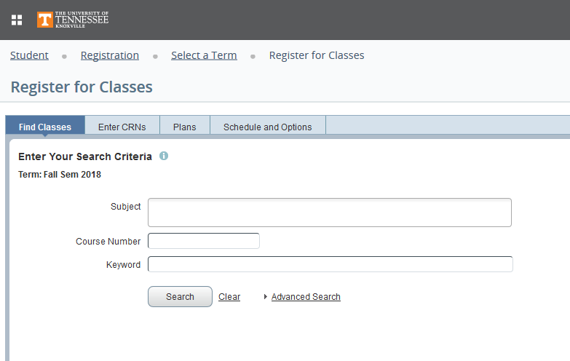
Register for Classes
From this point you can find courses through a subject/course number search, or by entering specific CRNs, or by utilizing plans/schedules you have saved

Slide 12
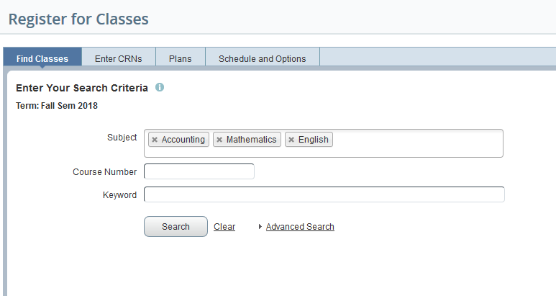
Search Criteria
You can search for one subject at a time or several at the same time

Slide 13
Search results will illustrate available course sections as well as the details for each course section

Slide 14
Schedule Details and Summary
You can see how a course fits into your schedule and the summary illustrates the course details but the course is in a ‘pending’ status until the submit button is clicked.

Slide 15
Schedule Details
Details for each course are available via the ‘Schedule Details’ tab

Slide 16
Schedule and Options
You can email and/or print your schedule

Slide 17
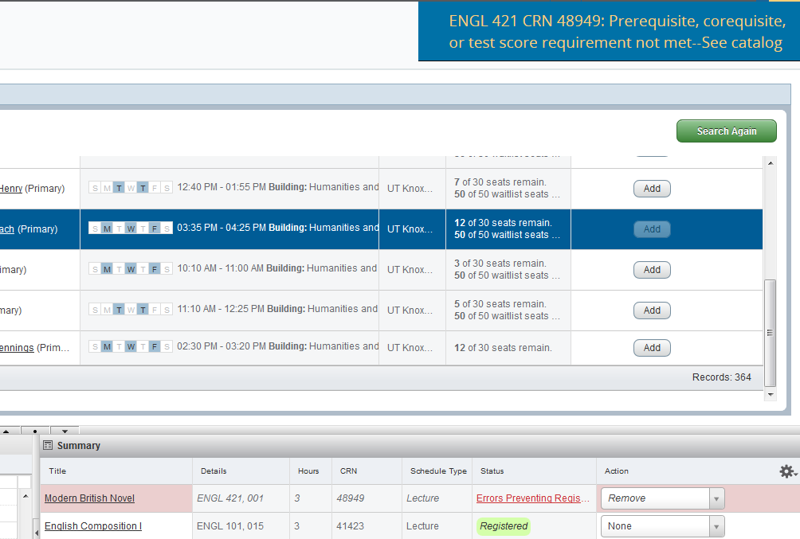
Registration Errors
Registration error codes are illustrated in the top right corner of your ‘Register for Classes’ worksheet

Slide 18
Registration Errors con’t
A pre-requisite and/or co-requisite requirement will be found via either the Undergraduate or the Graduate catalog. The link for the catalogs is found on the MyUTK main page under “Campus Services”.
Locate ‘Course Descriptions’ in the menu, use the drop-down ‘Prefix’ menu to find the academic discipline code. Click on the “Filter” button. Locate the course description - registration restrictions are listed.
Contact your academic advisor for assistance with additional questions you may have regarding pre-requisites and/or co-requisites.

