Slide 1
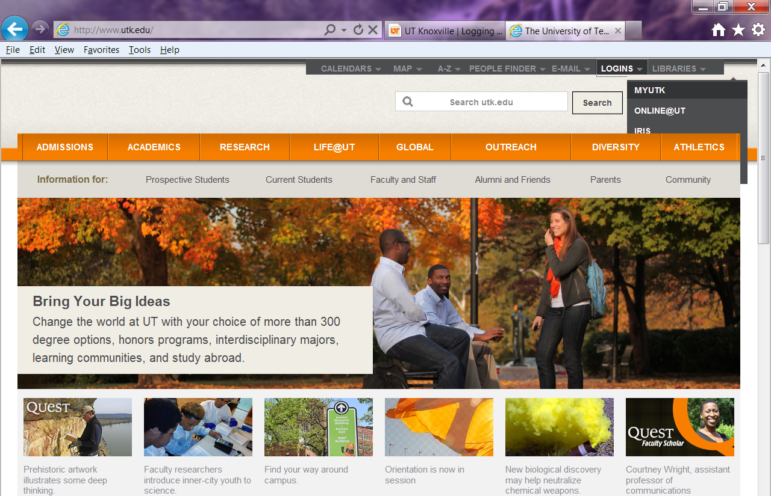
. . . HOW TO LOGIN
Go to http://www.utk.edu/
Select LOGINS
Select MyUTK

Slide 2
Enter NetID and password

Slide 3
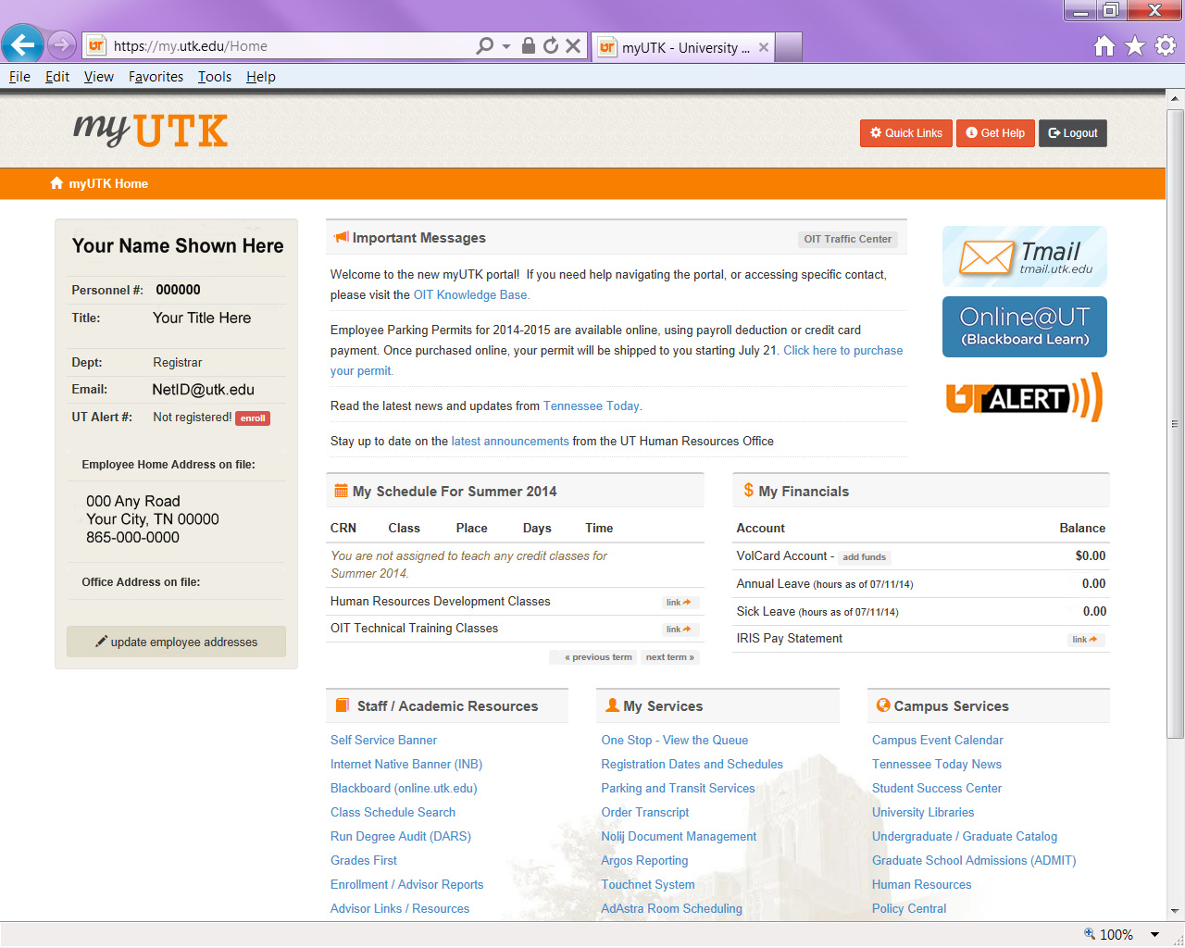
Everything you need – just a mouse click away

Slide 4
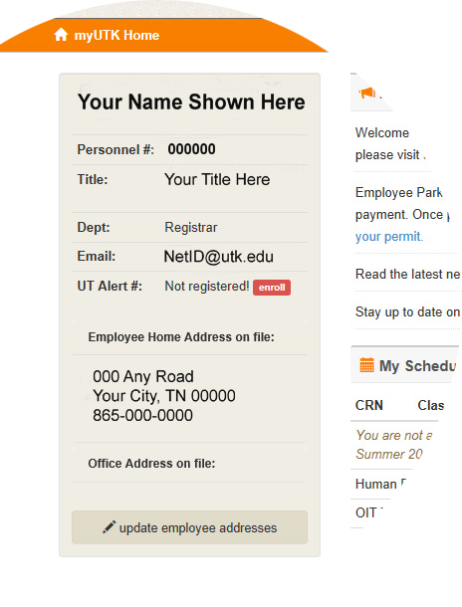
All your personal information is immediately available
Easy to update

Slide 5
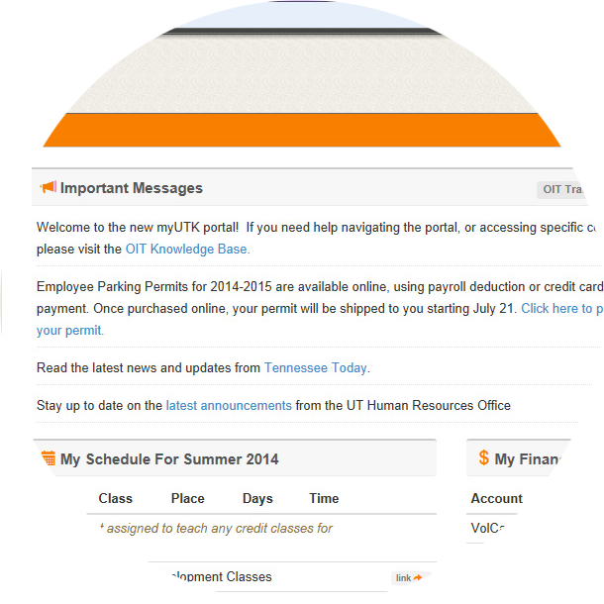
Check message center to stay up to date

Slide 6
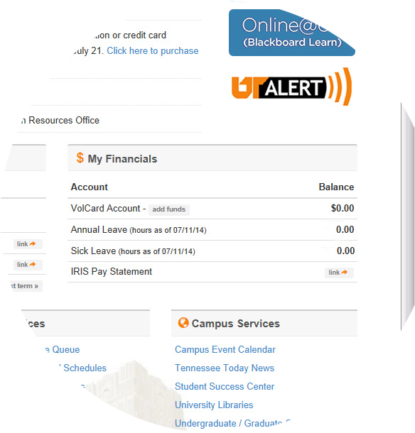
Check financial information at a glance

Slide 7
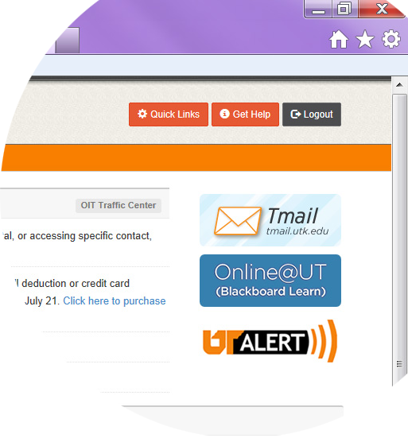
Help is at your fingertips

Slide 8
Resources & Services are all convenient

Slide 9
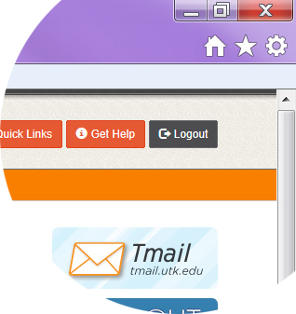
Don’t forget to logout and completely close your web browser for security reasons!

